Slide 1
STATE MANAGEMENT ON ASP.NET CORE APPLICATION

Slide 2
State Management on Stateless HTTP
HTTP is a stateless (or non-persistent) protocol. By default, HTTP requests are independent messages that don't retain user values or app states. A request will not know what was done in the previous requests. The protocol is designed to be stateless for simplicity. However, some Internet applications, such as e-commerce shopping cart, require the state information to be passed one request to the next. Since the protocol is stateless, it is the responsibility of the application to maintain state information within their application.

Slide 3
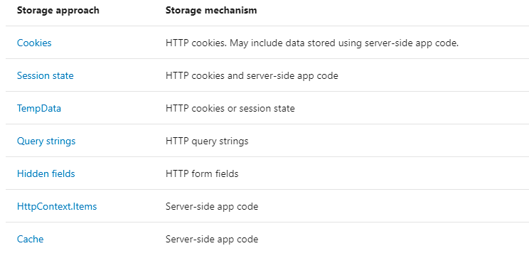
State can be managed using several approaches

Slide 4
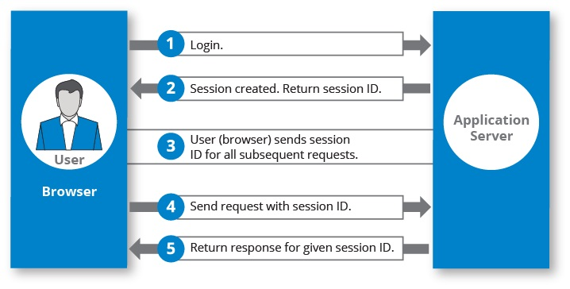
How session works

Slide 5
Server-Side Strategies Session state
Session state is an ASP.NET Core scenario for storage of user data while the user browses a web app. Session state uses a store maintained by the app to persist data across requests from a client. The session data is backed by a cache and considered ephemeral data. The site should continue to function without the session data. Critical application data should be stored in the user database and cached in session only as a performance optimization.
ASP.NET Core maintains session state by providing a cookie to the client that contains a session ID.
The browser sends the cookie send to the app with each request.
The application uses the session ID to fetch the session data.

Slide 6
Session state exhibits the following behaviors:
The session cookie is specific to the browser. Sessions aren't shared across browsers.
Session cookies are deleted when the browser session ends.
If a cookie is received for an expired session, a new session is created that uses the same session cookie.
Empty sessions aren't retained.
The session must have at least one value set to persist the session across requests. When a session isn't retained, a new session ID is generated for each new request.
The app retains a session for a limited time after the last request. The app either sets the session timeout or uses the default value of 20 minutes. Session state is ideal for storing user data:
That's specific to a particular session.Where the data doesn't require permanent storage across sessions.
Session data is deleted either when the ISession.Clear implementation is called or when the session expires.
There's no default mechanism to inform app code that a client browser has been closed or when the session cookie is deleted or expired on the client.

Slide 7
Using Session State in ASP.NET Core
We need to configure the session state before using it in our application. This can be done in the ConfigureServices() method in the Startup.cs class:
services.AddSession();
Then, we need to enable session state in the Configure() method in the same class:
app.UseSession();
The order of configuration is important and we should invoke the UseSession() before invoking UseMVC().

Slide 8
public class DemoController : Controller
{
public IActionResult Index()
{
HttpContext.Session.SetString("Name", "KBC");
HttpContext.Session.SetInt32("Code", 1234);
return View();
}
public IActionResult Read()
{
College obj = new College()
{
Name = HttpContext.Session.GetString("Name"),
Code = HttpContext.Session.GetInt32("Code").Value
};
return View(obj);
}
}

Slide 9
TempData
ASP.NET Core exposes the TempData property which can be used to store data until it is read. We can use the Keep() and Peek() methods to examine the data without deletion. TempData is particularly useful when we require the data for more than a single request. We can access them from controllers and views.
TempData is implemented by TempData providers using either cookies or session state.
public IActionResult Index()
{
TempData["StudentId"] = 1001;
return View();
}
public IActionResult Read()
{
var studentId = TempData["StudentId"] ?? null;
return View();
}

Slide 10
TempData is available when we read it for the first time and then it loses its value. Now, what if we need to persist the value of TempData even after we read it? We have two ways to do that:
TempData.Keep() / TempData.Keep(string key) – This method retains the value corresponding to the key passed in TempData. If no key is passed, it retains all values in TempData.
TempData.Peek(string key) – This method gets the value of the passed key from TempData and retains it for the next request.
var studentId = TempData["StudentId"]?.ToString();
TempData.Keep();
var studentId = TempData.Peek("StudentId")?.ToString();

Slide 11
HttpContext
A HttpContext object holds information about the current HTTP request. Whenever we make a new HTTP request or response then the Httpcontext object is created. Each time it is created and it creates a server current state of a HTTP request and response.
var userName = HttpContext.User.Identity.Name;

Slide 12
Client-Side Strategies Cookies
HTTP Cookie is some piece of data which is stored in the user's browser. Cookies store data across requests. Because cookies are sent with every request, their size should be kept to a minimum. Ideally, only an identifier should be stored in a cookie with the data stored by the app. Most browsers restrict cookie size to 4096 bytes. Only a limited number of cookies are available for each domain.
Because cookies are subject to tampering, they must be validated by the app. Cookies can be deleted by users and expire on clients. However, cookies are generally the most durable form of data persistence on the client.
Cookies are often used for personalization, where content is customized for a known user. The user is only identified and not authenticated in most cases. The cookie can store the user's name, account name, or unique user ID such as a GUID. The cookie can be used to access the user's personalized settings, such as their preferred website background color.

Slide 13
Reading Cookie
HttpCookie is accessible from Request.Cookies. Given below is the sample
Code.
private readonly IHttpContextAccessor _httpContextAccessor;
//read cookie from IHttpContextAccessor
string cookieValueFromContext = _httpContextAccessor.HttpContext.Request.Cookies["key"];
//read cookie from Request object
string cookieValueFromReq = Request.Cookies["Key"];

Slide 14
Writing cookie
public void SetCookie(string key, string value, int? expireTime)
{
CookieOptions option = new CookieOptions();
option.Expires = DateTime.Now.AddMinutes(expireTime.Value);
Response.Cookies.Append(key, value, option);
}
Remove Cookie
public void RemoveCookie(string key)
{
Response.Cookies.Delete(key);
}

Slide 15
Query strings
We can pass a limited amount of data from one request to another by adding it to the query string of the new request. This is useful for capturing the state in a persistent manner and allows the sharing of links with the embedded state.
public IActionResult GetQueryString(string name, int age)
{
User newUser = new User()
{
Name = name,
Age = age
};
return View(newUser);
}

Slide 16
We can retrieve both the name and age values from the query string and display it on the page.
As URL query strings are public, we should never use query strings for sensitive data.
In addition to unintended sharing, including data in query strings will make our application vulnerable to Cross-Site Request Forgery (CSRF) attacks, which can trick users into visiting malicious sites while authenticated. Attackers can then steal user data or take malicious actions on behalf of the user. For knowing more about protecting our application against CSRF attacks, visit Prevent Cross-Site Request Forgery (XSRF/CSRF) attacks

Slide 17
Hidden Fields
We can save data in hidden form fields and send back in the next request. Sometimes we require some data to be stored on the client side without displaying it on the page. Later when the user takes some action, we’ll need that data to be passed on to the server side. This is a common scenario in many applications and hidden fields provide a good solution for this.
<input id="Id" name="Id" type="hidden" value="101">
@Html.HiddenFor(model => model.Id)

